Slide 1


AMERICAN UNIVERSITY Online Marketing Strategy Analyses
ITEC – 660: BUSINESS INTELLIGENCE
COURSE PROJECT BY:
GROUP SEVEN [7]

Slide 2
Objectives
Assess AU's Online Marketing Effectiveness
Analyze the Findings on Enrollment, Marketing, Demographics, and Costs
Provide Recommendations Based on Findings

Slide 3

Has American University's Marketing Strategy Failed?

Slide 4
Findings and Insights
Large states with metropolitan centers had the biggest contribution to enrollment
02
Online marketing inadvertently increased in Bachelor enrollment
03
From 2012-2017, AU spent ~ 2.3M per lead
01
AU strategy has not Failed! YAY
04

Slide 5
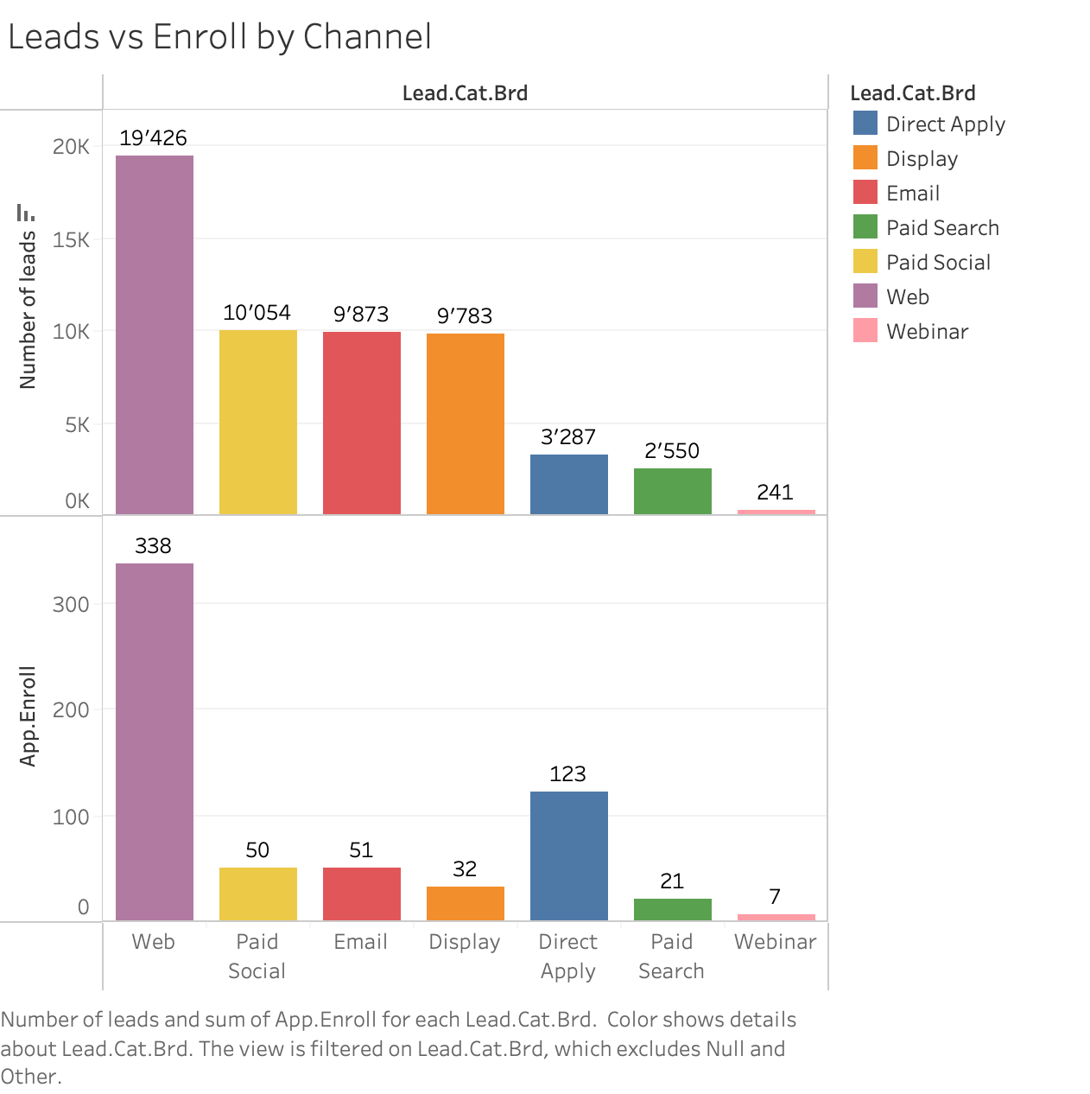
Enrollment Leads Outcome
The most effective method of achieving enrollments
Over 50% of enrollments generated through Web (search engine)

Slide 6
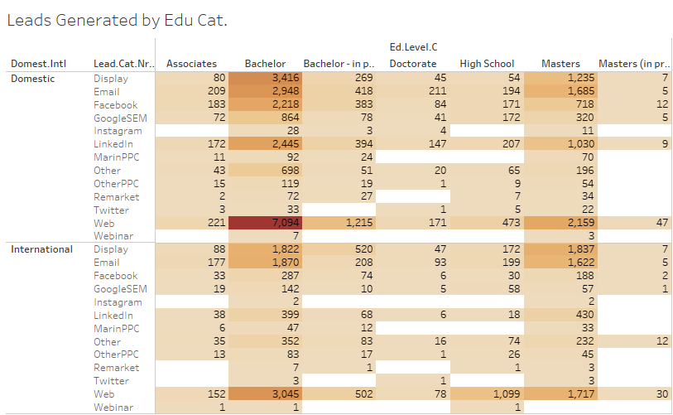
Leads Generated by Education Category
The Web method is very effective in generating leads from both domestic and international students
Social network methods generate fewer leads for international students than for domestic students
Twitter and Remarketing draw the least attention from students
The university can invest into faculty responses to master's enrollment related emails since emails were very effective in generating master's enrollment

Slide 7
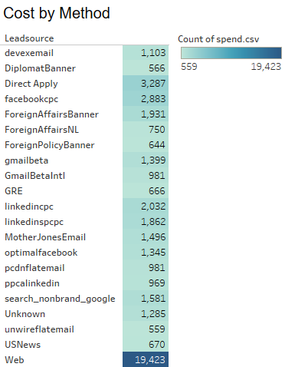
Lead Source Cost by Method
Website generated the most advertising spend of $19,432
The vast difference in the count of spend suggests that AU may be focusing its advertising efforts on a relatively small number of channels and that there may be opportunities to diversify its advertising strategy to reach new prospects
The "Direct Mail" and "Email" sources had relatively low levels of advertising spend compared to the other sources

Slide 8
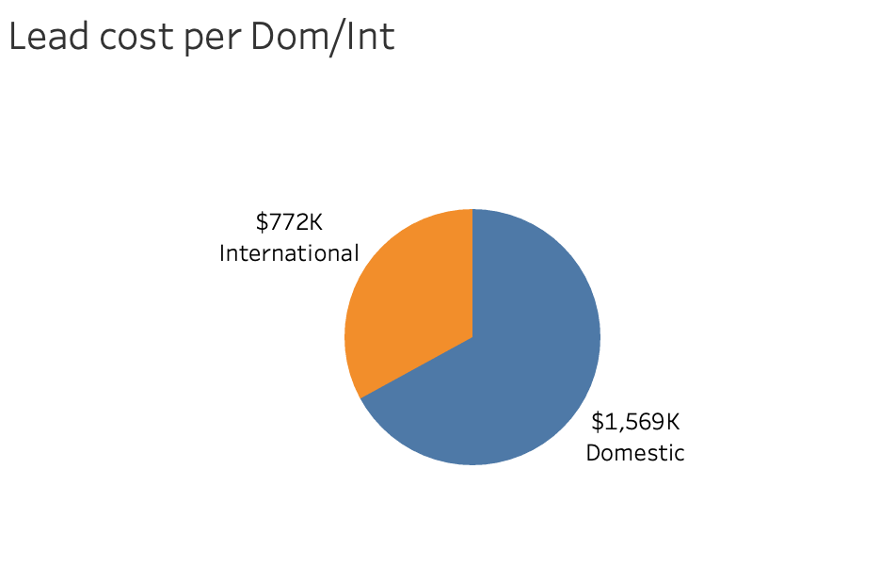
Lead cost by Dom. & Int. Students
The cost per lead for Domestic students is $1,569,000
International students has a lead cost at $772,000
This shows that acquiring a domestic lead is more than twice as expensive as acquiring an international lead.

Slide 9
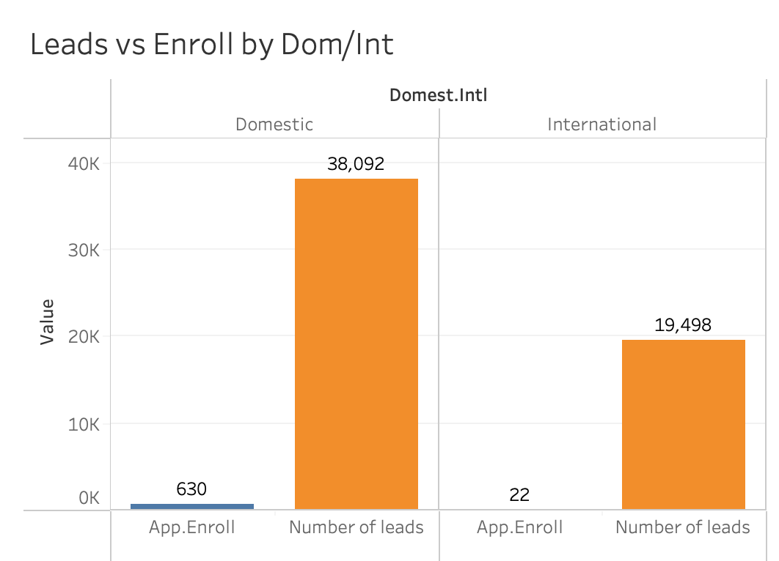
Lead vs Enroll International vs. Domestic
The overall lead for both Domestic and International students combined is 57,590.00
Domestic students have a marginally higher lead of 38,092 compared to International students at 19,498
Enrollment for International is at a low of 22,000 compared to enrollment from Domestic at 630,000

Slide 10
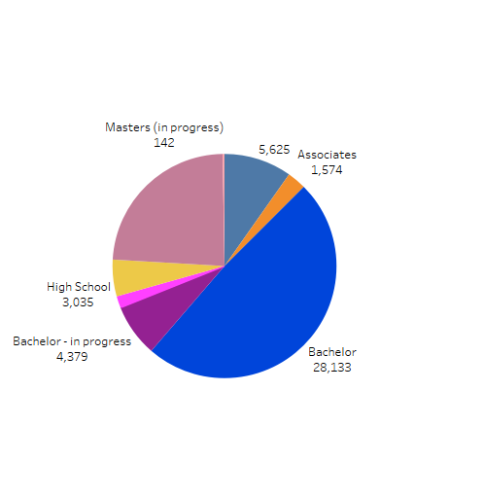
Previous Education of Enrolled Students
Over 50% of Enrolled Students have bachelor’s degree as their prior education
About 27% of Enrolled Student’s previous education has a master’s degree

Slide 11
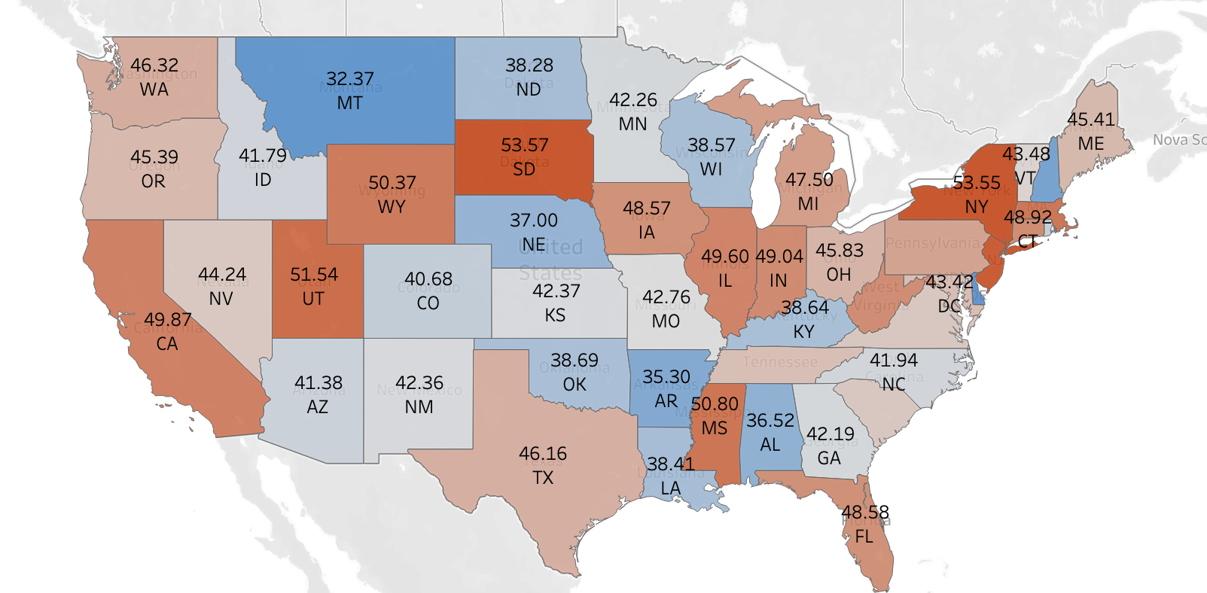
Average Lead Cost by State
Average Lead Cost by State
The states with the highest lead costs are:
New York (53.55)
New Jersey (53.01)
South Dakota (53.57)
The states with the lowest lead cost are:
Montana (32.37)
New Hampshire (34.40)
Delaware (32.27)

Slide 12
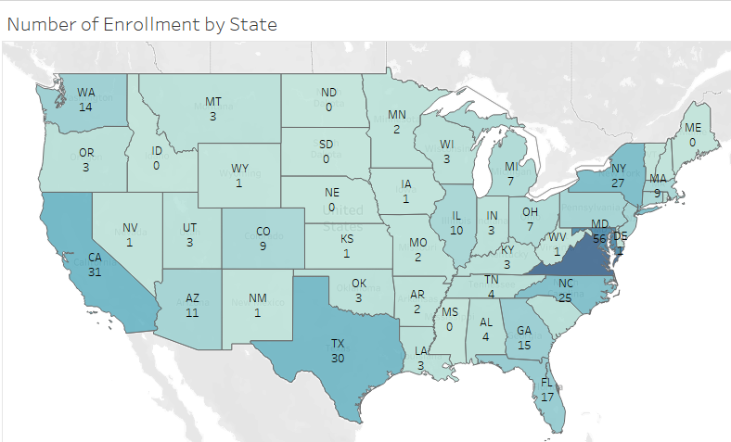
Enrollment Rate and Lead Cost Analysis by State
Montana has the highest enrollment rate of 3 with the lowest lead cost
South Dakota has the lowest enrollment rate of 0 with the highest lead cost

Slide 13
Recommendations
Improve website and online reputation
Retain bachelor graduates for master’s programs
(4 + 1 approach)
Invest more in states with high enrollment rates
Evaluate and optimize marketing and enrollment costs
Attract more international students

Slide 14
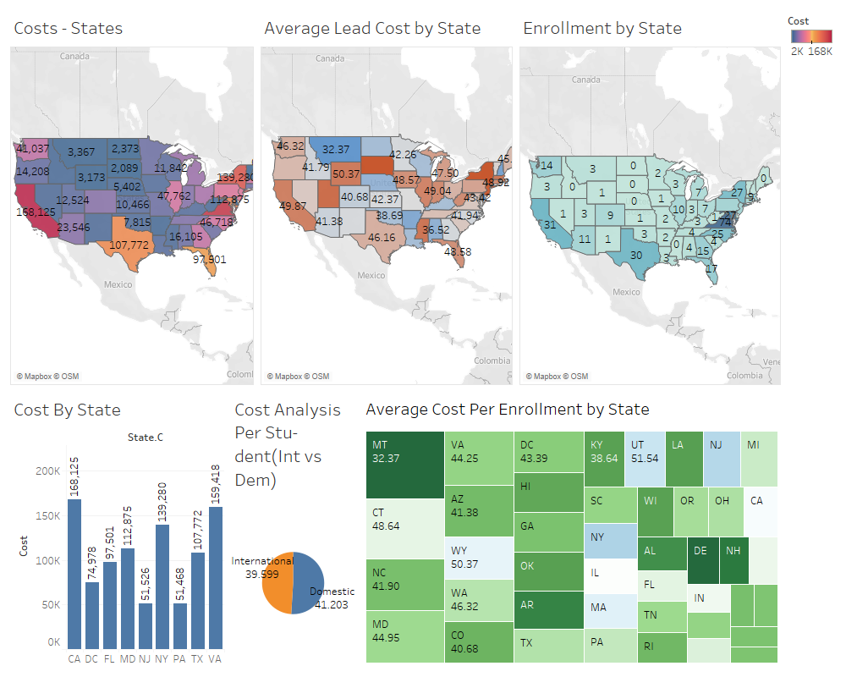
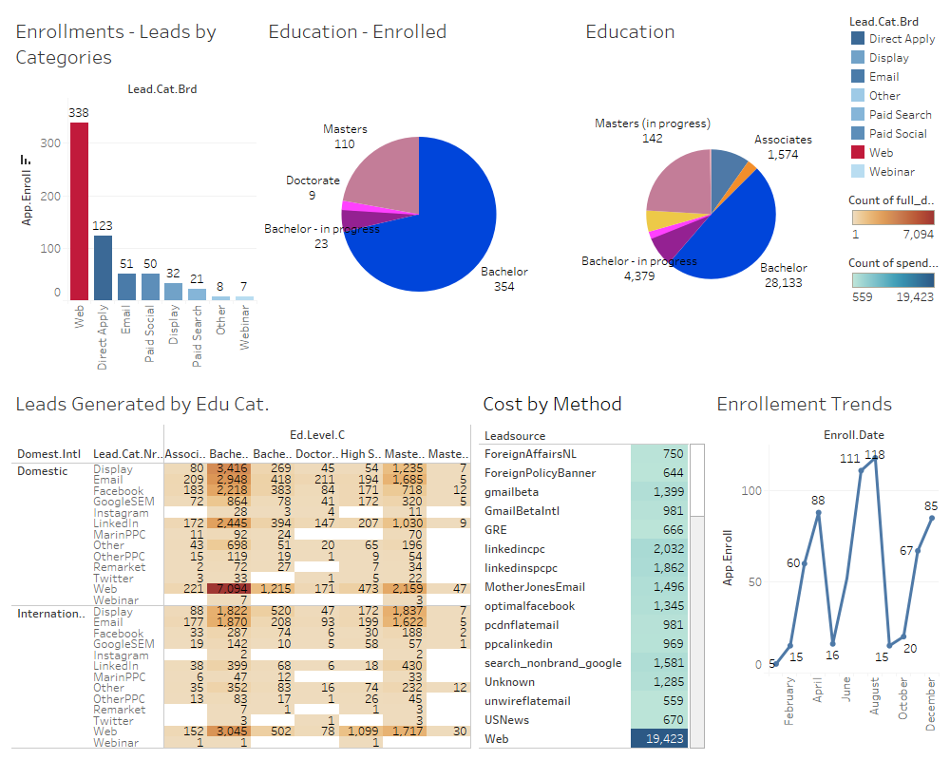

Slide 15

Thank You!
Q&A

